Slide 1

Quick Sort Algorithm
Understanding the Quick Sort Algorithm

Slide 2

Introduction
Quick Sort is an efficient, in-place sorting algorithm that follows the divide-and-conquer strategy

Slide 3

How Quick Sort Works
1. Choose a 'pivot' element from the array.
2. Partition the array into two sub-arrays:
* Elements less than the pivot.
* Elements greater than the pivot.
3. Recursively apply the above steps to the sub-arrays.

Slide 4
Advantages of Quick Sort
1. Efficient for large datasets.
2. In-place sorting algorithm (uses only a small, constant amount of extra storage space).
3. Generally faster than other O(n log n) algorithms like merge sort and heap sort.

Slide 5
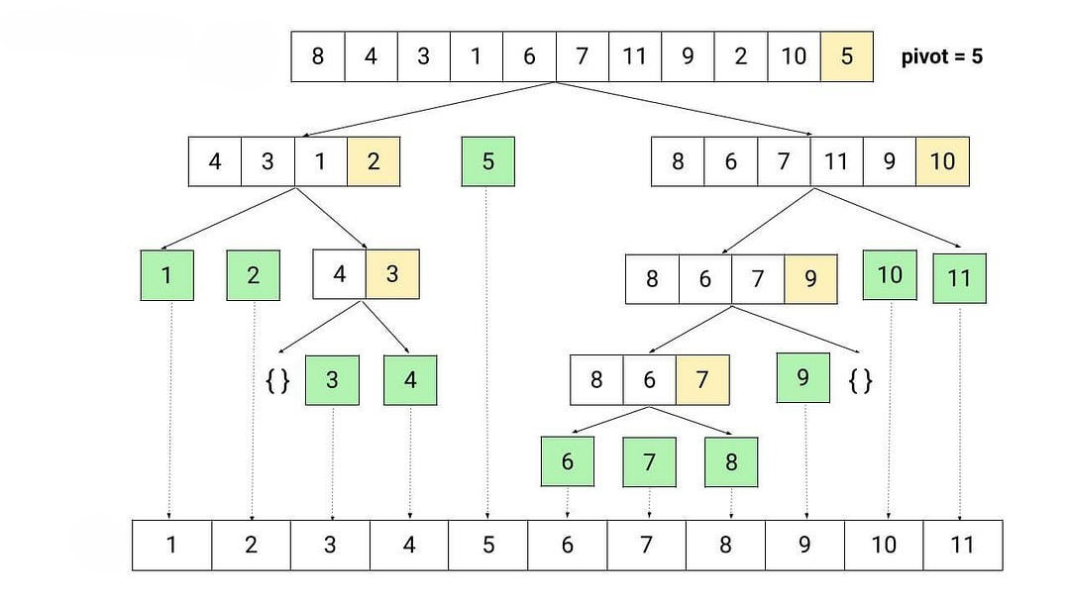

Slide 6

Partition Function (Pseudocode)
Algorithm partition (array, first, last) {
pivot = array[first]
i = first
j = last
while (i < last) {
do {
i = i + 1
}
while (array[i] <= pivot)
do {
last = last - 1
} while (array[last] > pivot)
if (i < last) {
swap(array[i], array[last])
}
}
swap(array[first], array[last])
return j
}

Slide 7
Quick Sort Function (Pseudocode)
Algorithm quicksort(array, low, high) {
if (low < high) {
pivotIndex = partition(array, low, high)
quicksort(array, low, pivotIndex)
quicksort(array, pivotIndex + 1, high)
}
}

Slide 8

Analysis for quick sort
T(n)=T(n-1)+n T(n-1)=T(n-2)+(n-1) T(n)=[T(n-2)+(n-1)]+n T(n-2)=T(n-3)+(n-2) T(n)=[T(n-3)+(n-2)](n-1)+n k=n-1 T(n)=T(n-k)+(n-k-1)+(n-k-2)+…+(n-1)+n => Pattern
T(n)=T(1)+2+3+..+n T(n)=T(1)+(n*(n+1)/2)-1 T(n)=n*(n+1)/2
O($n^{2}$) The final answer

